Slide 1
Predicting customer buying behaviour
BY: Tushar Khadangle

Slide 2
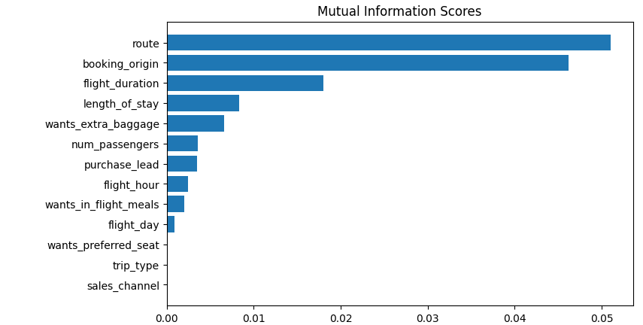

Slide 3
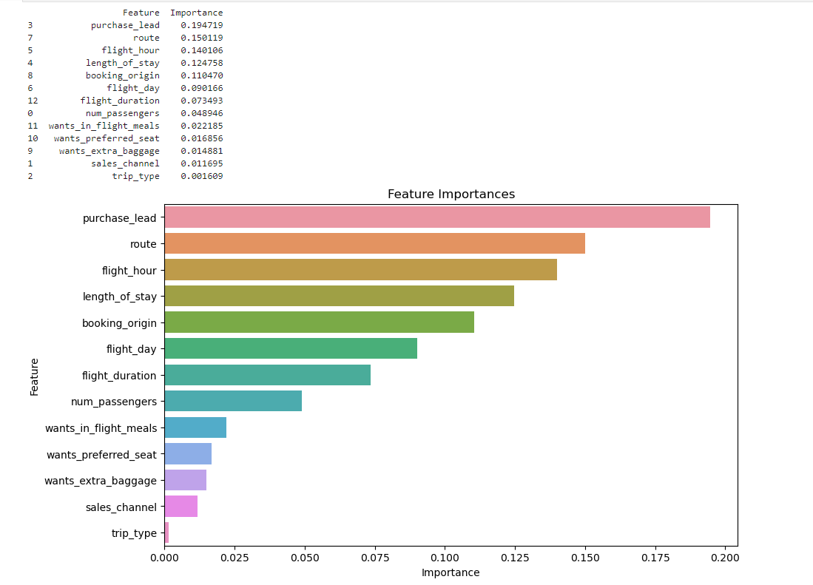

Slide 4
Both analyses highlight the route, booking origin, and length of stay as significant features, suggesting strong and consistent predictors of booking completion.
Purchase Lead: The time between booking and the flight date is
highly influential, emphasizing the importance of early bookings.
Flight Hour: Time of the flight is another critical factor, which was less
highlighted in the MI scores but
ranks high in the model importance.
The Accuracy of the model is 85.09

